Slide 1
AWS Academy Guide

Slide 2
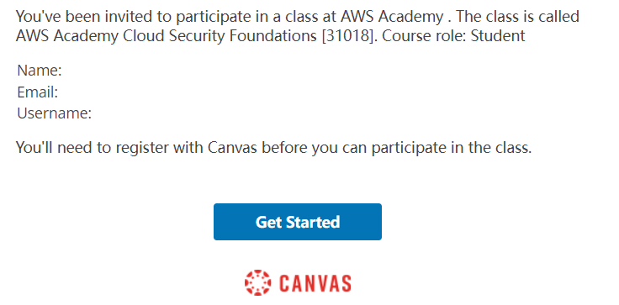
Step 1: Invitation Email
Check your NP email inbox to get the invitation email, click the “Get Started” link to access AWS Academy.

Slide 3
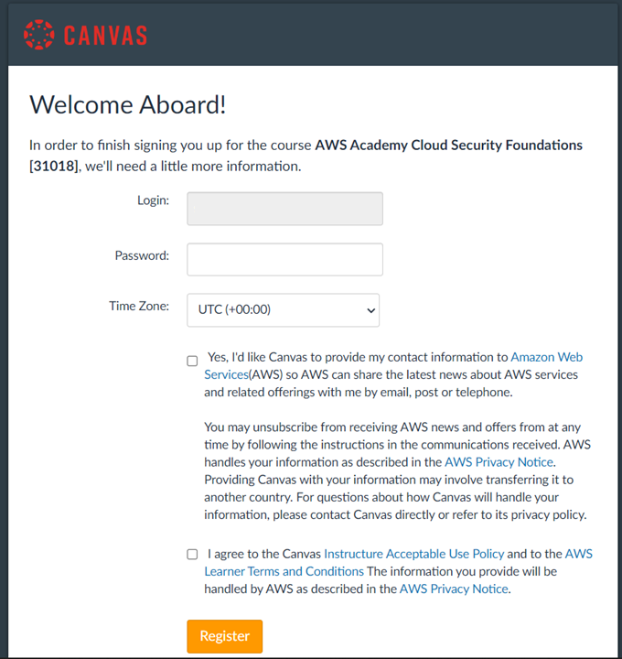
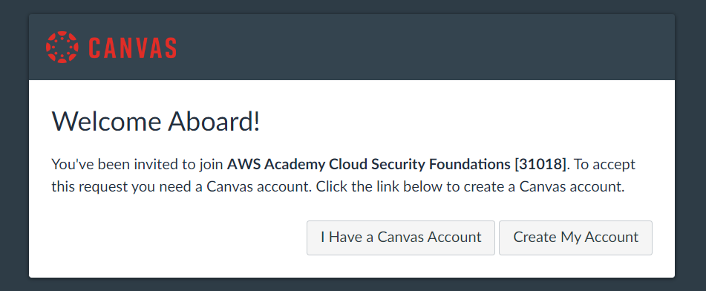
Step 2 : Account Creation
If you have used your NP email to register Canvas before, click “I have a Canvas Account” to login.
If this is the first time you access Canvas, click “Create My Account”.
Your NP email will be used as login ID, you just need to create your own password and then click “Register”.

Slide 4
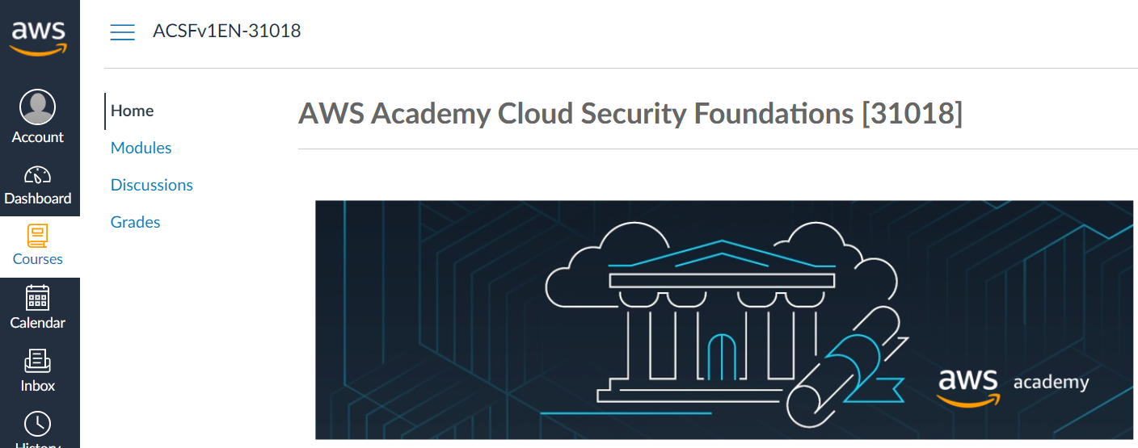
Course Home Page
You will be re-directed to the homepage of the course.
You may click “Modules” to explore the contents, but to take note that NOT all contents are required for SCS module.

Slide 5



Guide to Access AWS Cloud Labs
The following labs are required in Week 4, 6 & 7 practical sessions.
Refer to the next few slides for accessing the lab environment.

Slide 6
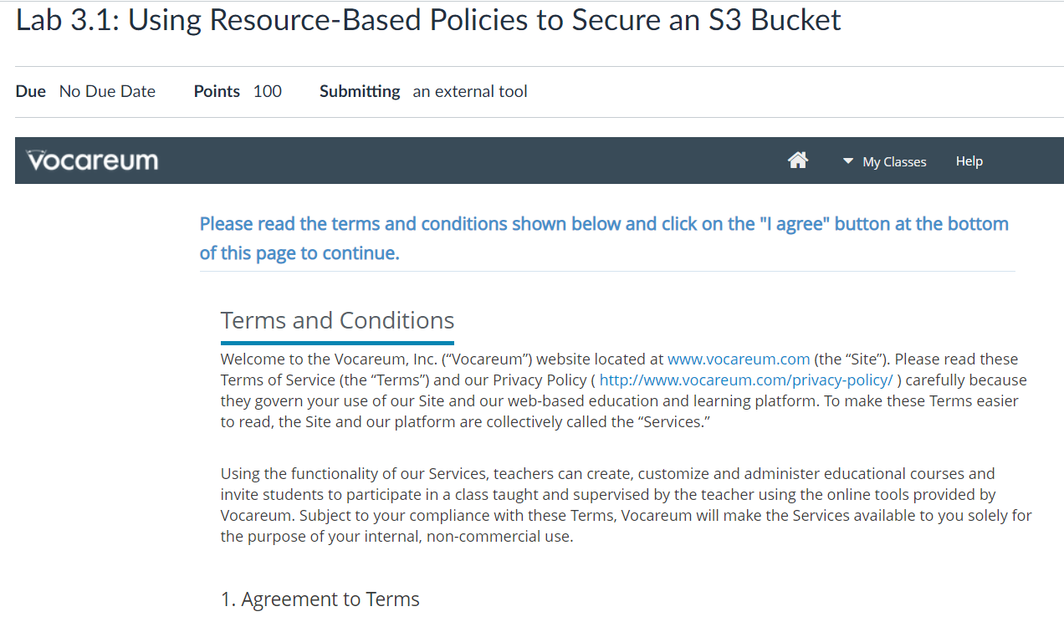
Agree on Terms and Conditions
Simply agree on the Terms and Conditions for the first time you access the lab.

Slide 7
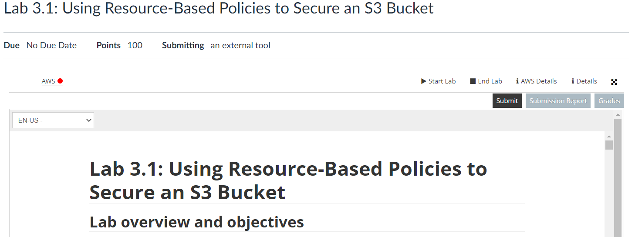
Lab Access Example
Click “Start Lab” and the red light indicates that the cloud environment is being prepared.

Slide 8
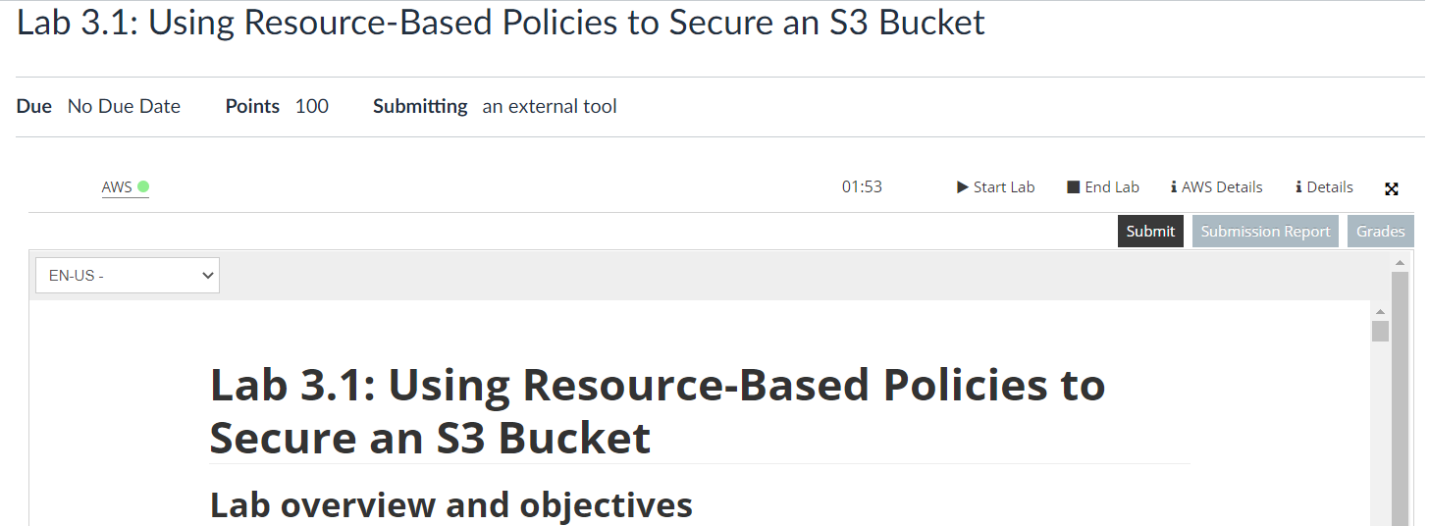
Lab Access Example
Once the light turns green, click it and a new browser window will be opened for lab access.

Slide 9
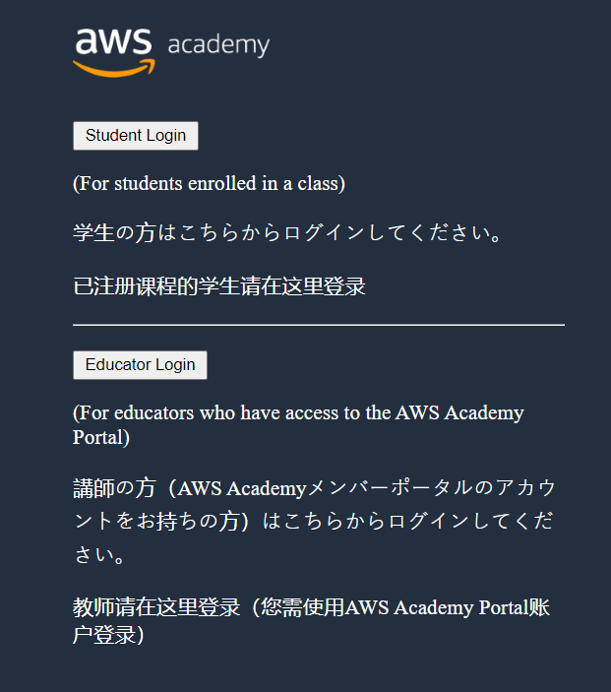
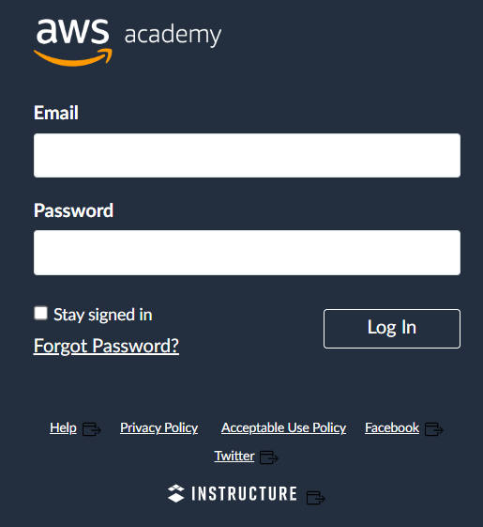
Future Access
For future access to AWS Academy, you may directly use the link below:
https://www.awsacademy.com/LMS_Login
Choose “Student Login” and enter your credentials.

